Slide 1
2023 Mental Health Leadership Seminar
A Roadmap for Mental Health Professionals and Public Safety Leadership
Noon- 12:45p Lunch sponsored by PRIMEX
Afternoon Program 12:45-4pm
Welcome Mental Health Professionals! Please be sure to sign in for CEs
Continuing Education (CEs) for Mental Health Professionals sponsored by Professional Fire Fighters of NH (PFF-NH)
& New Hampshire Psychological Association (NHPA)

Slide 2
Mini-Presentation: Is my Colleague in Trouble?
A RoadMap for Mental Health Clinicians & Public Safety Leadership
Jeffrey Stewart, NRP, I/C, CAI
Owner Dragon Shield Consulting

Slide 3
Intro’s & Disclaimers:
1986: EMS
Military – Private – Hospital – Municipal EMS
Provider – Educator – Leader
1998: Street/Designer Drug Education
2012: Addiction Interventionist (ARISE® certified) & started Dragon Shield Consulting, LLC,
Intervention, Education, Coaching, Consulting, etc.
THIS IS NOT A PROGRAM TO TEACH OR CREDENTIAL OR CERTIFY YOU as an INTERVENTIONIST!
Notes:
35 years in EMS – includes military / focus on SUD education 23 years / Formally working with SUD / MH clients 10 years

Slide 4
Objectives:
By the end of this program the participant will be able to:
Describe at least 5 signs / symptoms that a Public Safety Professional may display or express that indicate the individual is experiencing a crisis.
Introduce the PRO-QL & modified LSI assessment tools & how they may be utilized with your peers, colleagues, or staff.

Slide 5
Case-in-Point
Clinical & Educational Director of EMS Agency with 275 EMT’s / Paramedics in Mass.
Saturday Afternoon 26 NOV 2011
Phone Rings
“Hey Jeff, FYI – XXXX got arrested today for Drunk Driving.”
About 3 hours later
Phone Rings
“Hey Jeffrey this is Sgt. from XXX PD I need to speak with you about….”
Notes:
This was one of my Paramedics

Slide 6
What are your thoughts?
32 y/o male
Army Veteran
Paramedic
Sadness
Anger
Frustration
BOCPP: “there goes my weekend”
Notes:
I failed him – What did I miss -

Slide 7
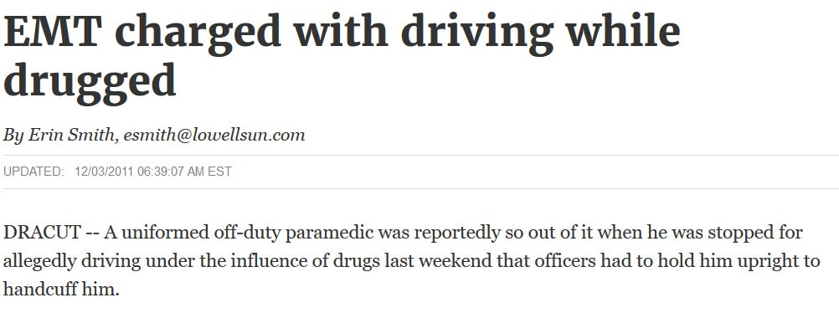

Slide 8
Public Safety / First Responders
Rescue Personality

Slide 9
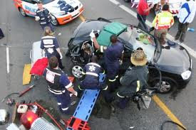
Rescue Personality (Mitchell & Bray 1990) ….
Inner-directed
Action oriented
Obsessed with high standards of performance
Traditional
Socially conservative
Easily bored
Highly dedicated
Notes:
Ok this concept has been around 20+ years some clinicians run with it others dismiss it – for todays purposes as we look at the subject matter it applie. My point here is breaking down the silos between the Public Safety sectors.

Slide 10
Compassion Fatigue
Job Unbalanced
Satisfaction
Dis-satisfaction
Good Stuff vs. Bad Stuff
Acute Stress Disorder
Post event(s) symptoms last less than 30 days.
Post Traumatic Stress Disorder
Post event(s) symptoms last greater than 30 days.
Notes:
Compassion Fatigue – not recognized from a clinical DSM V perspective (diagnosis) / ASD & PTSD are.

Slide 11
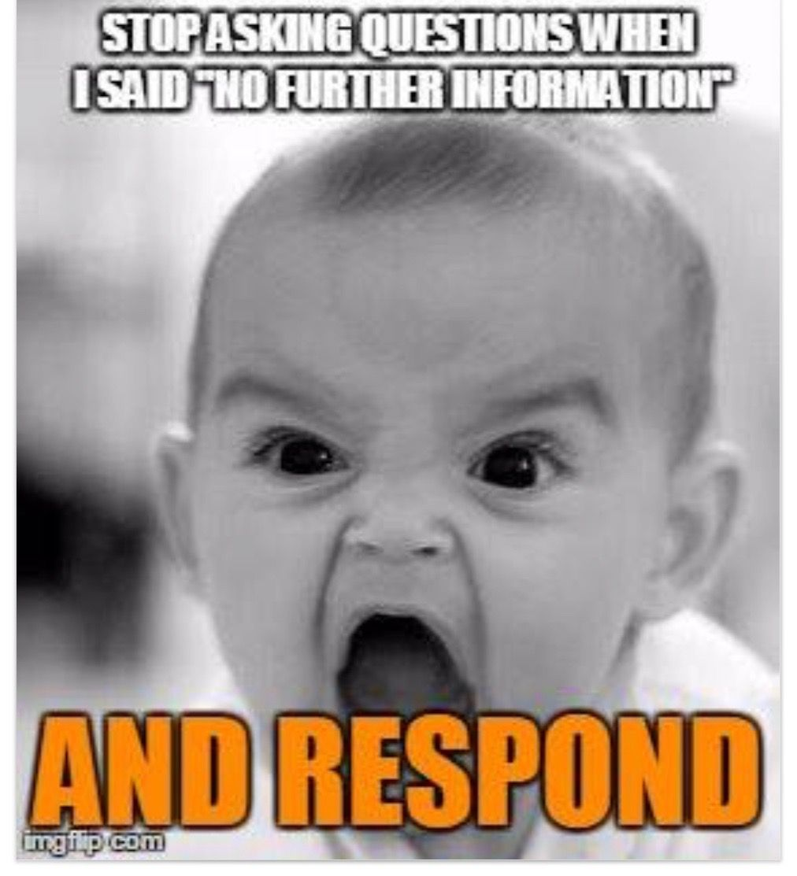
General Symptomology
Flashbacks
Nightmares
Avoids places / event reminders
Memory issues
Feeling of numb
Loss of interest
On edge
Sleep disturbances
Easily startled
Etc.
Notes:
2 slides coming up: This is general discussion and a nod to our dispatchers in the audience -

Slide 12
What might we see/hear to raise concerns?
Isolation
Tardiness / Absent
Weight gain/loss
Increase in OT
Insubordination
Anger
Conflict
Comments
Substance Use
Patterns / Patterns / Patterns

Slide 13
Professional Quality of Life
Compassion Satisfaction
Positive aspects of helping people
The “Good Stuff”
Compassion Fatigue
Negative aspects of helping people
The “Bad Stuff”
Notes:
My Medical Folks in the room – HOMEOSTASIS / For the rest of us Yeng – Yang / Balance

Slide 14
CS-CF Model
Professional Quality of Life
Compassion Satisfaction
Compassion Fatigue
Burnout
Secondary Trauma
PRO-QL Handout
Notes:
BURNOUT: A condition of being very physically & emotionally tired after doing a job for a long time / so when I hear newbies profess about burnout – I see it as either mimicking comments-behaviors from the senior staff – which means I need to get on top of it and address it OR they may be a little more of the Compassion Fatigue state and I still want to get on it and address it – we as leaders have to keep abreast of the “tide” / “mood” / “moral” / “pulse” of our staff.
SECONDARY TRAUMA – consequences of unaddressed fatigue – could be physical, emotional, lead to other more problematic problems – we need to work to prevent this as leaders

Slide 15
LSI’s: Life Stress Indicators
Chief Goldstein covered the Terrible 10:
LODD Colleague Suicide
Death/Inj. Child MCI
Long/failed Rescue Victim known to Responders
Safety Jeopardized Administrative Betrayal
Excessive Media Coverage
Other significant event produces considerable emotional distress
DSC – LSI Handout
Notes:
Other Sig. Event = Medication Error results in severe injury or death of patient // failed to recognize/correct life ending injury // Officer involved shooting // In custody death // etc.

Slide 16
Suicide
Intentional Act of taking one’s life.
It is anger, aggression, sadness, loneliness, emptiness, etc. TURNED INWARD.
It is PAIN – physical, emotional, spiritual. PAIN
It is possible with any depressed person.
10 – 22 – 5- 1
8 in NH
Ideation / Threat-Gesture / Attempt
IS PATH WARM
SAD CAGES
If you think it = ASK
Maj. Conte will discuss the Decision Tree for Emergency or Not.
Notes:
CDC, DOD, VA, OSHA, ACS, NPHN, as of 2021.

Slide 17
Take Aways
Identify / Benchmark
Develop Policies / Procedures / Trainings
Not just on….
Awareness of issue
But on….
What to do if
Where to go for
Improve Resilience Capital
Celebrate Successes
Learn from misses
Don’t Ask = Don’t Know
Use an assessment tool
ProQoL / LSI’s / etc.
Lots available
Treat this like you do any of your other CQI measuring points
Build it into….
Reviews
Trainings
Culture

Slide 18
REMEMBER…….
You are not going to put the idea in their head!
If you THINK it – ASK it!
Are you considering killing or harming yourself?
DSC: Pocket Card

Slide 19
THANK YOU!!
Contact Information:
jmsdragonshield@gmail.com
1-855-NODRUGZ
CELL: 603-370-0691

Slide 20
A Road Map…

Slide 21
My Employee is NOT ok
I know this because…
Document the exposure
I have observed concerning behaviors
He/She told me
Bad call, I’m worried about them
Someone else told me
Is this credible?
Might the employee be at risk for self-harm?
Maybe
YES
NO
Call Peer Support OR approach the employee yourself
YES
Maybe? I’m not sure…
NO
Is the employee able to work?
ASK: Are you thinking about hurting yourself?
*DO NOT leave the person alone
*Relieve from Duty
*Remove Firearms
*Transport to ER
*Call Peer Support
NO
Place on Leave
Call Peer Support
Contact your MHP
Referral for MH Svc
FFDE for return to work
Consider WC paperwork
YES
Peer Support
Referral for MH Svc
Wellness Consult
Therapy/Txmt

Slide 22
My Employee is NOT ok
I know this because…
Document the exposure
I have observed concerning behaviors
He/She told me
Bad call, I’m worried about them
Someone else told me
Is this credible?
Might the employee be at risk for self-harm?
Is there or will there be DISCIPLINE involved?
Maybe
YES
NO
YES
Do you suspect that the behavior is the direct result of a MH issue?
Call Peer Support OR approach the employee yourself
YES
Maybe? I’m not sure…
YES
NO
Is the employee able to work?
ASK: Are you thinking about hurting yourself?
*DO NOT leave the person alone
*Relieve from Duty
*Remove Firearms
*Transport to ER
*Call Peer Support
NO
Place on Leave
Call Peer Support
Contact your MHP
Referral for MH Svc
FFDE for return to work
Consider WC paperwork
YES
Peer Support
Referral for MH Svc
Wellness Consult
Therapy/Txmt

Slide 23
10 minutes please

Slide 24
2023 MENTAL HEALTH LEADERSHIP Seminar
Services/Interventions
Susan brown lcmhc, mladc, emt-I (ret)

Slide 25
SAVING LIvES AND CAREERS
Eliminating stigma and barriers to care
How do I get someone help and where do I start?

Slide 26
Prevention
Training
Early intervention
Critical Incident Stress management
Peer support

Slide 27
Levels and types of care;
Medical Detoxification
Involuntary Emergency Admission
Inpatient Acute Care and Residential Substance Use or Mental Health Treatment
Partial Hospitalization Programs (4-5 x a week, 4-8 hours daily)
Intensive Outpatient Treatment (3-5 x week, 9-15 hours total per week)
Outpatient Individual Psychotherapy
Medication Evaluation and Medication Management
Clinical Outpatient Treatment Groups
Peer Support
Self-Help/Peer Support Groups
Mental Health and Substance Use Treatment
First Responder Specific Resources

Slide 28
Don’t hesitate to reach out!
Mental Health clinicians can help you understand and navigate these resources

Slide 29
Forge VFR
Intensive Outpatient Program
9-15 hours weekly
Outpatient Therapy Groups
Outpatient Individual Counseling
All services address Mental Health and Substance Use related issues
Serving; First Responders. Veterans, and currently serving Service Members

Slide 30
Types of treatment
So confusing!

Slide 31
Cognitive Behavioral Therapy (CBT)
Cognitive Therapy (CT) – derived from CBT
modifying pessimistic evaluations and memories of trauma, with goal of interrupting the disturbing behavioral and/or thought patterns that have been interfering in the person’s daily life
Prolonged Exposure Therapy – specific type of CBT
teaches individuals to gradually approach trauma-related memories, feelings and situations (90 minute sessions, 8 – 15 sessions)
Mindfulness Based Cognitive Behavioral Therapy
builds on CT using techniques such as mindfulness meditation to teach clients to consciously pay attention to thoughts and feelings without judgment
Solution-Focused Brief Therapy (SFBT)
short-term goal-focused evidence-based therapeutic approach, which incorporates positive psychology principles and practices, and which helps clients change by constructing solutions rather than focusing on problem
focuses on the relationships between thoughts, feelings and behaviors;
targets current problems and symptoms;
focuses on changing patterns of behaviors, thoughts and feelings that lead to difficulties in functioning’s

Slide 32
A few other trauma specific treatments
Eye Movement Desensitization and Reprocessing Therapy (EMDR)
structured therapy that encourages the patient to briefly focus on the trauma memory while simultaneously experiencing bilateral stimulation (typically eye movements), which is associated with a reduction in the vividness and emotion associated with the trauma memories (1 – 2 x weekly, 6 – 12 sessions)
Narrative Exposure Therapy
helps individuals establish a coherent life narrative in which to contextualize traumatic experiences
Cognitive Processing Therapy (CPT) - specific type of CBT
patients learn how to modify and challenge unhelpful beliefs related to the trauma (12 sessions)
https://www.apa.org/ptsd-guideline/treatments

Slide 33
Thank You
Susan Brown LCMHC, MLADC
603-865-1701
sbrown@forgehealth.com
www.forgehealth.com

Slide 34
What do I really need for this situation?
Wellness Consultation
Fitness for Duty Evaluation (FFDE)
Vs
Confidential meeting with MHP: I will receive no report or information, just a bill for the service as proof of attendance
I’m ordering this for the benefit of the employee
I have minimal concern for the employee’s mental fitness for duty or safety, only for his/her general wellbeing
I want my employee to get connected to care if he/she needs it
I want my employee to be able to talk about what happened/what’s going on and not worry about it getting back to me or anyone else
The City/Town/Department will pay for this service as a sign of support and validation that it is good to ask for help
I can mandate/order/require attendance so there is no stigma associated with needing it.
Psychological Evaluation: I will receive a report with information relevant to the employee’s fitness for duty and/or recommendations for next steps
I’m ordering this to protect the department, the employee, his/her coworkers, and the public from any negative outcomes of this employee’s demonstrated difficulties.
I have documented cause to believe that the employee may be struggling with a MH issue that is impacting their fitness for duty (an OIS is not reason enough!)
I am so concerned about this employee’s fitness that I have relieved him/her of duty pending the results of this evaluation.
The employee has been out on leave for MH issues and says he/she is ready to return to duty, I need to make sure that treatment (or time) has indeed helped this employee regain his/her mental fitness before allowing them back on the job.
The City/Town/Department is prepared to pay for this service because ensuring the mental fitness of our employees is of the utmost priority.

Slide 35
Wellness Consultation:
What to know:
How to use it:
Typically, the department schedules the appt for the employee
The department will agree to the confidentiality terms and the fee ahead of the appt, in writing
The employee will sign a consent form upon arrival to appt that explicitly explains the confidential nature of the consultation
The employee can use the time with the MHP as they see fit
The provider will send you a bill after the appt
A consult can be requested at anytime for any reason
A consult an be conducted by any culturally competent MH clinician
Inexpensive option to support employees
Dept/Town/City pays for the service
No documentation is maintained
After a particularly bad call
Immediately following an OIS (one-on-one debrief) for the benefit of the employee
Prior to returning to duty after an OIS (as a for the employer)
Annually
For special teams and task forces as a means for MH maintenance (ICAC, SWAT, Accident Reconstruction, etc)
Observed disconcerting behaviors that do not rise to safety or fitness concerns
After an extended absence from job (military deployment, bereavement, injury, etc.)

Slide 36
Fitness for Duty Evaluation (FFDE):
What to know:
You are not required to provide a copy of the report to the employee
The report may be used in future WC claims
Have a psychologist you trust that performs your FFDEs
Just because someone is found to have no psychological/behavioral impairment and thus “passed” the exam, does not necessarily mean they are a good employee
Expect several weeks lead time to get an appointment
The appt will last from 3-5 hours
You will provide to the psychologist ahead of the appt: documentation of the concerns, a referral question, and the employee’s job description (at minimum)
You will receive a report that contains information about the employee that is relevant to their fitness to do the job as described. This may or may not include a diagnosis.
You will not get any information about the employee’s fitness ahead of the report.
The psychologist does not typically share or discuss results with the employee.
Recommendations and results are accepted or rejected at your discretion.
The report should be written in clear language, no psycho-babble, no “T- scores” or “standard deviations”.
Report must be protected as PHI (medical records)-not in personnel file
Must be completed by a licensed psychologist
FFDEs are expensive and invasive with potential legal ramifications
Dept/Town/City pays for the service
How to use it:
Concerning behaviors have raised questions of fitness for the job (ie insubordination, citizens complaints, aggression, concerns for self-harm, poor recovery from trauma, substance use, derelict of duty, etc)
FFDE is NOT punitive
Can provide insight and options for supporting an employee
If an employee is in need of treatment, allow them time to “get better” before ordering the FFDE
Hot Tip: Really good PEPEs are 1/3rd the price of a FFDE!! Prevention Works!

Slide 37
Need to know: the ethics of the MHP
Once an MHP has done a wellness consult with your employee, he/she cannot later conduct a FFDE (or a PEPE)
The treating MHP cannot conduct the FFDE (or the PEPE)
The treating MHP can (with patient authorization) provide helpful documentation and opinions on fitness (sometimes in lieu of or to aide FFDE), but often wont.
Even when the department has arranged for treatment- if the employee is paying for it themselves or with insurance- the dept has no rights to any information (protected by HIPAA)- not even the employee’s attendance
The treating MHP will always place the treatment relationship above the needs of the department

Slide 38
Other factors to consider:
When the department/town/city is paying for the service- then the dept/town/city is the “client” and is entitled to and owns the information relevant to the execution of a safe and healthy work environment (except Wellness Consults). The MHP’s obligation is to the dept/town/city.
When the employee is paying for the service (self-pay or insurance), he/she is the “client” and is protected by HIPAA to the fullest extent of the law- with customary limits to confidentiality.
When workers compensation is involved, the treating MHP is obligated to provide sufficient documentation to justify medical necessity for the treatment or service, which includes all treatment notes. This is well above typical disclosure requirements for payment.
Workers Compensation cases often leave MHPs unpaid for many months (even years) of care with no guarantee of ever being paid.

Slide 39
MHP ethics to consider:
MHPs should be careful not to take a hard line against communicating with employers. Consider the information being requested and how you might meet the need without violating patient trust. Discuss with the patient exactly what will be communicated to their employer and be explicit in Informed Consent and Authorization to Release:
Would your willingness to share that the patient has consistently attended appointments and has made progress toward treatment goals save the patient from a highly invasive FFDE?
Would your willingness to share diagnostic information and symptom manifestation aide in the patient being authorized to take needed leave from the job? Thus, allowing him/her improved healing time and space?
When in doubt, seek consultation with colleagues
Often departments don’t want details, they want data

Slide 40
The MHP might not be willing to talk:
Why?
Trust. The therapy space is sacred and safe. Introducing the vulnerability that comes with directly connecting work and treatment is a risk often not worth taking.
Because sometimes the individual’s recovery is more important than his/her job.
Because if the outcome of the employment side is poor, the risk that the individual feels betrayed or let down by the provider who talked is high.
Because treatment providers often do not feel competent in assessing for fitness and are not willing to make such a statement.
Because treatment providers understand that they are inherently biased in their perception of the individual and the depth of understanding of the needs and life circumstances. These influences might skew the assessment provided.
Because if the treatment provider supported the individual’s return to work and they fail/struggle, shame and humiliation may interfere with the treatment relationship.
Because the treatment provider may not believe that the individual is fit to return to duty but to officially say this would interfere with the individual’s willingness to continue to work and get better in treatment.

Slide 41
So…your employee has been out on a MH injury and says he/she is ready to come back to work…
Now What?
Well, if the employee was relieved of duty due to MH concerns, their fitness to return to duty will need to be confirmed. This is typically done via an FFDE or note from a MH provider (if they are willing). You are not obligated to accept the opinion of an employee’s provider. You have the right to request an independent exam (you don’t have to accept their opinion either!).
If the employee was out on admin leave or using sick time or workers compensation, you have options:
Accept the employee’s word that they are “good” and put them back to work
Require a wellness consultation for good measure
Require a FFDE
Accept a note from the employee’s MHP (if they are willing)
What you choose to do will likely be reflective of the nature of the employee’s injury/event, duration of absence, and your observation of their wellbeing (light duty is sometimes a good means of “observation”)
If you are not confident that the employee is as ready as he/she thinks they are, an FFDE is the best approach
It doesn’t hurt to have a guidelines in place for these types of situations, so all employees are treated fairly and equally, minimize risk for unintended bias
Hot Knowledge: Inpatient facilities & programs DO NOT “clear”employees for return to duty

Slide 42
Chief Kirk Beattie, (Retired)
Chief Anne Perriello, LCSW
Employee Reintroduction, Education, & Accountability
Do you address concerning patterns of behavior that are occurring outside of work, prior to them becoming an issue?
How do we reintroduce an employee back into the work setting after mental health leave?
Gradual introductions back to a full day?
Assuring there is a therapeutic connection before and after the return to duty.
Returning equipment prior to restoring to duty?
Increase staffing over the course of a few shifts during the transition
Are you educating your supervisors on mental illness signs, symptoms, patterns of behavior etc…
Did you give your supervisors the tools to address the concerning behavior?
Sensitivity training for all employees, however holding the supervisors accountable for” breaking the stigma.”

Slide 43
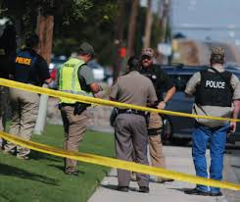
Closing Remarks THANK YOU Director Justin Cutting & Director John Scippa

